Slide 1
Requirements:
Vector CANoe
Generic Library (clone repo: https://elc-github.magna.global/Magna-Electronics/D2H7520_GENLIB_Generic_Testing_Libs.git)
For more details regarding test support functions check:
Docs\Doxygen_GFE_Documentation_Release.zip\html\_main_page_8c.html

Slide 2
Step 1:
Add to the system variables the following files:
GenericLibraries\baseLib\RS232\sysvarRS232.vsysvar
ProjectSupportLib\controlLib\DUT\DUT_PrjSupport.vsysvar
GenericLibraries\SupportNodes\PowerSupply\sysvarPowerSupply.vsysvar
GenericLibraries\SupportNodes\TestMain\sysvarMainPanel.vsysvar
Step 2:
Add include in .can file: ProjectSpecific\GenLib_Includes.cin for Generic Test Case template
Example of generic template can be found in: Docs\TestCaseExample

Slide 3
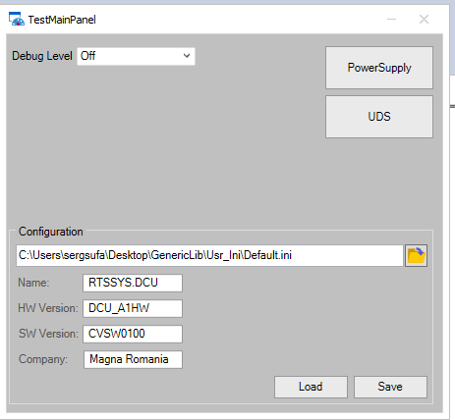
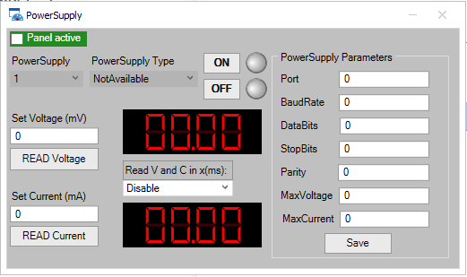
TestMain and PowerSupply panel
Path TestMain: GenericLibraries\SupportNodes\TestMain
Path PowerSupply: GenericLibraries\SupportNodes\PowerSupply

Slide 4
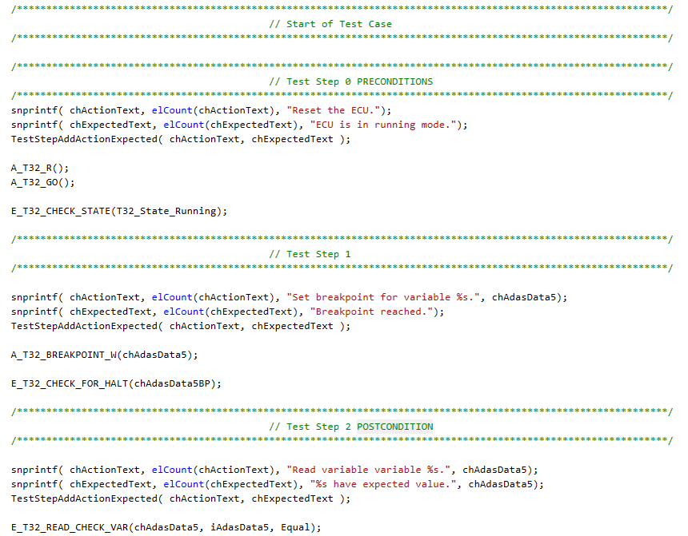
Generic Test step structure:
- Each step can have multiple action functions but only one expected function.
- chActionText must contain all the action for the corresponding step.
- chExpectedText must contain the expected outcome.
- Test case MUST start with Pre-conditions and end with Post-conditions. Pre-conditions: ensure that the ECU is in correct state for your test. Post-conditions leave the ECU in “default” state, example: no faults, running mode etc.

Slide 5
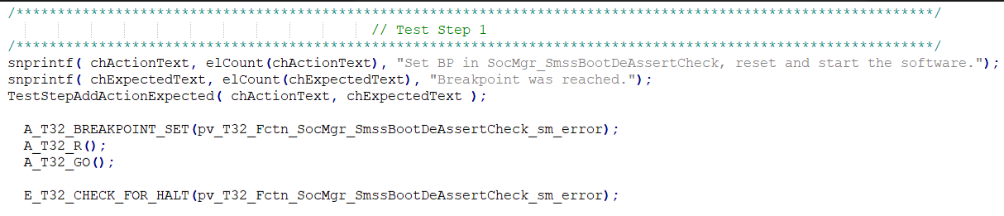
Test steps examples:
Breakpoint set and check

Slide 6
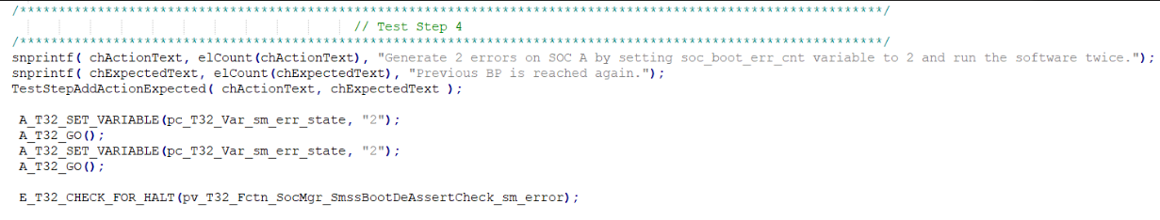
Test steps examples:
How to set a variable value

Slide 7
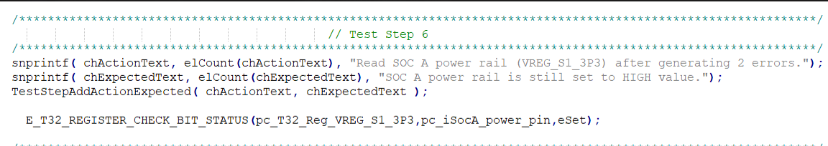
Test steps examples:
How to check register bit status

Slide 8
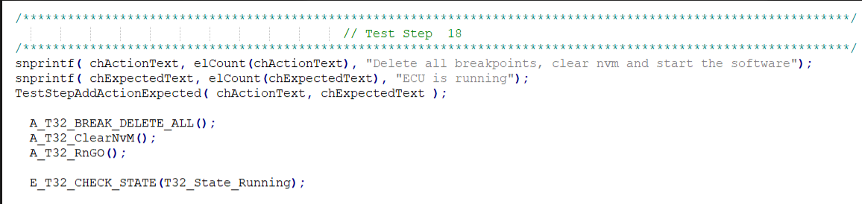
Test steps examples:
Example of pre/post conditions

Slide 9
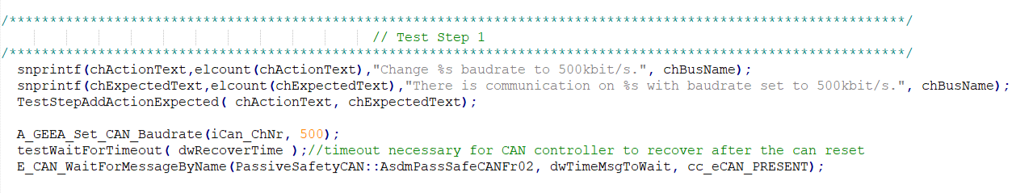
Test steps examples:
System: geely(ignore) example of baudrate setting and check message present

Slide 10
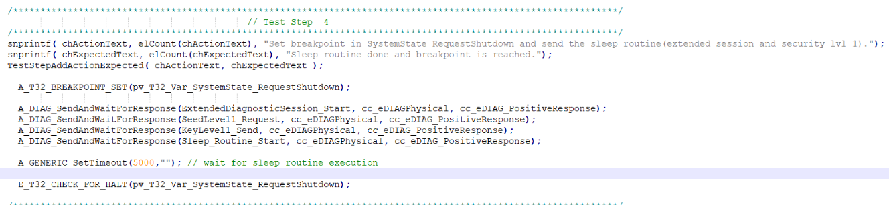
Test steps examples:
Usage of diag functions

